Slide 1


Invincible Apps with Dapr
Paul Yuknewicz
Head of Product, Azure Serverless Microsoft Corporation
@paulyuki99
linkedin.com/in/paul-yuknewicz-50a91125/
Notes:
Good morning, everyone!
It’s great to be back at the Dev Intersection Conference.
This is one of my favorite events, thank you so much for having me.

Slide 2
Doing more
+
2
with less
–
Notes:
We are going through a period of historic economic, societal and technological change. But for all the uncertainty we continue to see in the world, one thing is clear: organizations in every industry are turning to you to help them do more with less, so that they can navigate this change and emerge much stronger.
You are the change agents who make doing more with less possible – less time, less cost, less complexity, with more innovation, more agility and more resilience.
Doing more with less doesn’t mean working harder or longer.
It means applying technology to amplify what you can do, and ultimately, what an organization can achieve amidst today’s constraints.

Slide 3
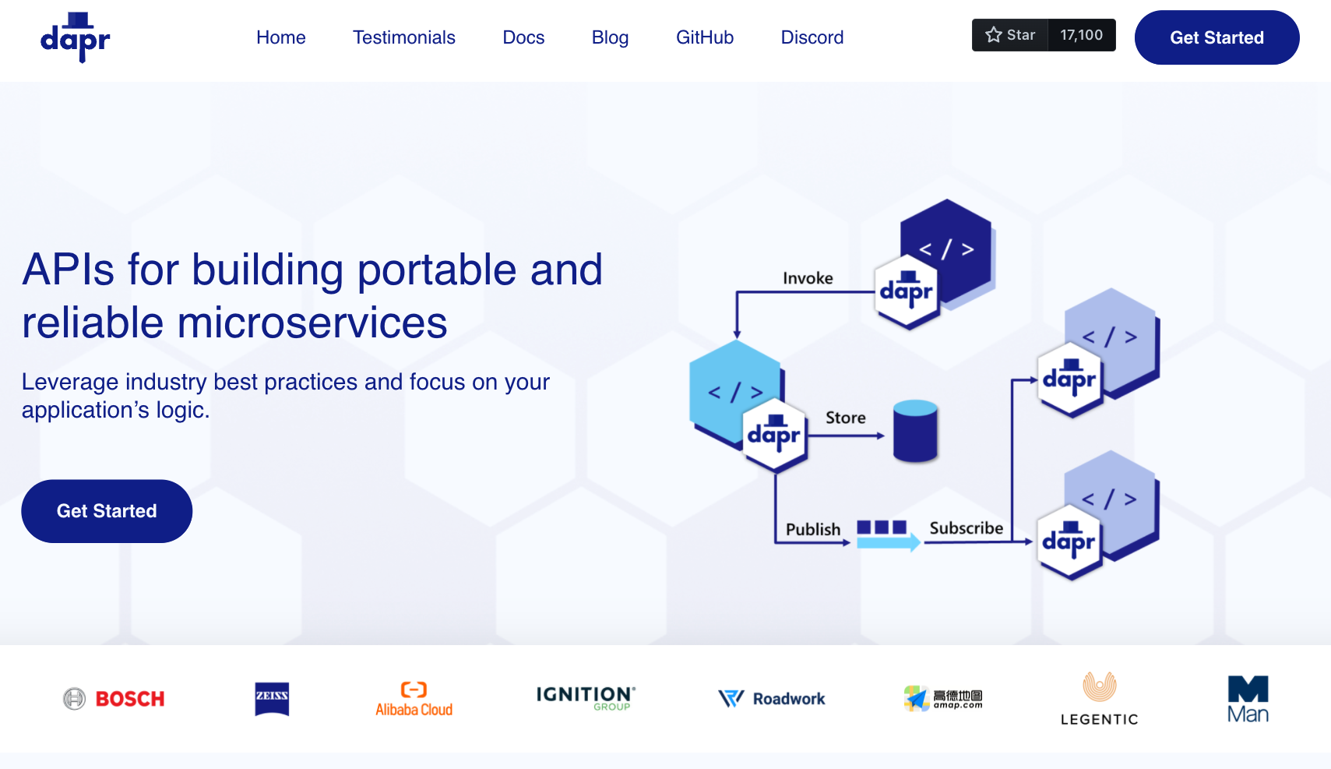

Slide 6
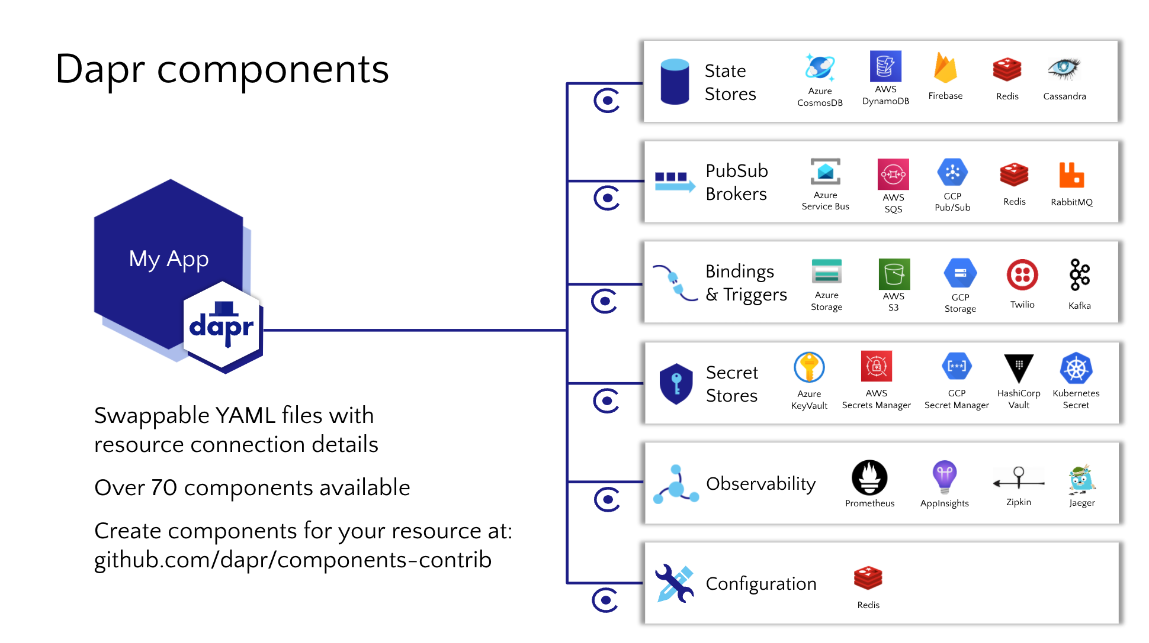
107

Slide 7
var order = new Order(100);
using var client = new DaprClientBuilder().Build();
// Publish an message using Dapr PubSub
await client.PublishEventAsync("order_pub_sub", "orders", order);

Slide 8
Event Driven Scaling KEDA + Dapr
Built-in scalers for multi vendor databases, messaging systems, metrics, CICD, and more.
Works alongside Kubernetes Horizonal Pod Autoscaler
Built-in to Azure Container Apps
Extensions for Azure Kubernetes Service
CNCF incubations project

Slide 10
DEMO
Lap around Dapr

Slide 11
Resiliency
Resiliency patterns applied consistently across all Dapr building blocks APIs
Notes:
Thanks, Paul for the Dapr overview.
Hi everybody, now that we've had a brief overview of Dapr I’m going to give you a quick glimpse into an exciting new capability that Dapr will be releasing in the near future, which is the ability to apply resiliency policies to your Dapr API calls.
Just to provide some context on resiliency and why it’s important -
Distributed applications are commonly comprised of many moving pieces - there could be dozens or even hundreds of instances for any given service.
With this many moving pieces, the likelihood of a system failure increases. An instance can fail for any number of reasons, for example, hardware failures, overwhelming number of requests, application restarts/scale outs. Any of these events can cause a network call between services to fail.
Having your application designed with the ability to detect and mitigate these failures allows for your application to respond and recover quickly back to a functioning state.
We’ve heard that configuring an app to be “resilient” take a lot of time an expertise.
Often leads to cluttered application code that wrapped in repetitive retry logic.

Slide 12
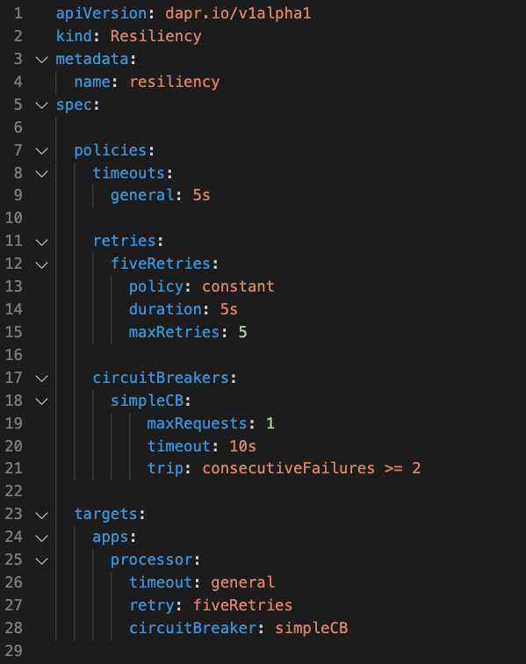
Resiliency
Introduced in v1.7
Common resiliency patterns can be applied consistently across Dapr building blocks
Decoupled from application code
Compatibility across all component types, service invocation and actors.
Notes:
With that importance, Dapr is introducing resiliency capabilities that you can apply to your Dapr API calls.
This capability is targeting preview in the Dapr 1.7 release, which is shipping early next week.
This capability introduces a new YAML concept called ”Resiliency” and this YAML file sits alongside your component files. The resiliency YAML allows for defining custom resiliency polices for common resiliency patterns. For example, timeouts, retries/backoffs and circuit breakers.
You define these policies and apply them to ”targets” – which are ”apps”, “components” and “actors”. This essentially covers all the Dapr building block APIs.
The nice thing about this implementation, which unlike popular frameworks, such as Polly. These policies are configured and applied at a configuration level keeping your application code and business logic clean and unaware of these resiliency patterns and behaviors.
Second iteration
Metrics.
Include “sane” defaults/base policies - specify targets and rely on Dapr to provide “sane” default policies.
CEL logic resiliency – allows for more granular policy scoping. Can scope it to a specific HTTP action – POST requests only apply X policy.

Slide 15
var client = new HttpClient();
// 1-line change: Dapr app id as part of the header
client.DefaultRequestHeaders.Add("dapr-app-id", "order-processor");
var order = new Order(100);
var orderJson = JsonSerializer.Serialize<Order>(order);
var content = new StringContent(orderJson, Encoding.UTF8, "application/json");
// Invoking the /orders service
var response = await client.PostAsync($"{baseURL}/orders", content);
Console.WriteLine("Order passed: " + order);
public record Order([property: JsonPropertyName("orderId")] int OrderId);
Notes:
Additional language samples here, Java etc.

Slide 20
Resiliency
Resiliency patterns applied consistently across all Dapr building blocks APIs
Notes:
Thanks, Paul for the Dapr overview.
Hi everybody, now that we've had a brief overview of Dapr I’m going to give you a quick glimpse into an exciting new capability that Dapr will be releasing in the near future, which is the ability to apply resiliency policies to your Dapr API calls.
Just to provide some context on resiliency and why it’s important -
Distributed applications are commonly comprised of many moving pieces - there could be dozens or even hundreds of instances for any given service.
With this many moving pieces, the likelihood of a system failure increases. An instance can fail for any number of reasons, for example, hardware failures, overwhelming number of requests, application restarts/scale outs. Any of these events can cause a network call between services to fail.
Having your application designed with the ability to detect and mitigate these failures allows for your application to respond and recover quickly back to a functioning state.
We’ve heard that configuring an app to be “resilient” take a lot of time an expertise.
Often leads to cluttered application code that wrapped in repetitive retry logic.

Slide 21
Resiliency
Introduced in v1.7
Common resiliency patterns can be applied consistently across Dapr building blocks
Decoupled from application code
Compatibility across all component types, service invocation and actors.
Notes:
With that importance, Dapr is introducing resiliency capabilities that you can apply to your Dapr API calls.
This capability is targeting preview in the Dapr 1.7 release, which is shipping early next week.
This capability introduces a new YAML concept called ”Resiliency” and this YAML file sits alongside your component files. The resiliency YAML allows for defining custom resiliency polices for common resiliency patterns. For example, timeouts, retries/backoffs and circuit breakers.
You define these policies and apply them to ”targets” – which are ”apps”, “components” and “actors”. This essentially covers all the Dapr building block APIs.
The nice thing about this implementation, which unlike popular frameworks, such as Polly. These policies are configured and applied at a configuration level keeping your application code and business logic clean and unaware of these resiliency patterns and behaviors.
Second iteration
Metrics.
Include “sane” defaults/base policies - specify targets and rely on Dapr to provide “sane” default policies.
CEL logic resiliency – allows for more granular policy scoping. Can scope it to a specific HTTP action – POST requests only apply X policy.

Slide 22

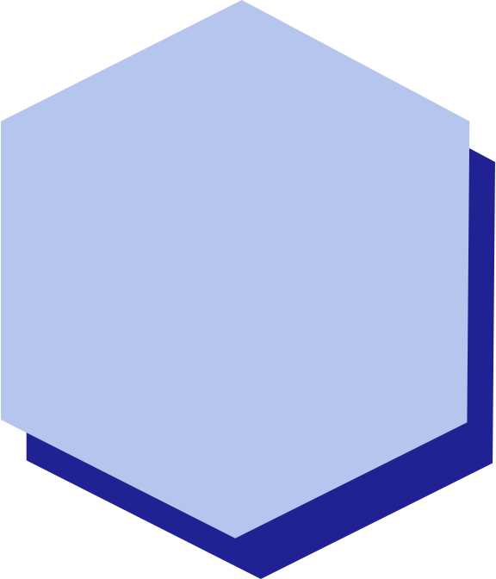
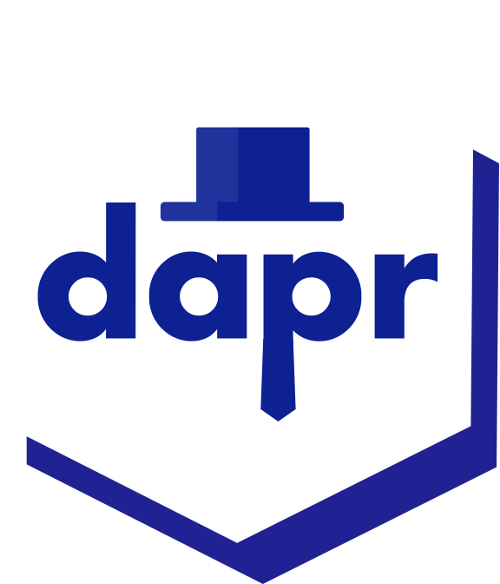
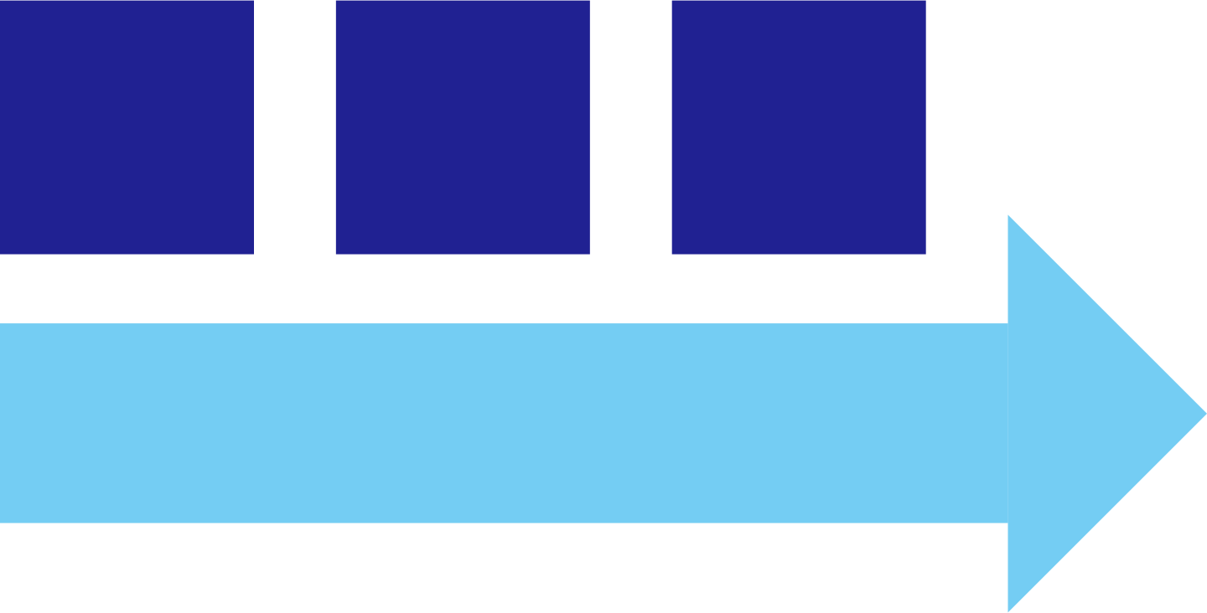
Resiliency in Pub/Sub
1
1
Outbound component resiliency policies for `retries`, `timeouts and `circuit breakers` can be applied to message publishing
Inbound component resiliency polices for `retries`, `timeouts and `circuit breakers` policies can be applied to subscriptions when delivering messages
Service A
Service B
Outbound
Pub/sub queue
Inbound
1
Additionally, many pub/sub components have `retry` capabilities built-in. The policies are configured on a per component basis. For example, Kafka, RabbitMQ and Redis

Slide 23
Service invocation resiliency policies
1
The built-in service invocation retries are always performed with a backoff interval of 1 second up to a threshold of 3 times
Service A
Service B
1
Additionally, service invocation resiliency polices for `retries`, `timeouts and `circuit breakers` can be applied

Slide 24
Outbound component resiliency policies
1
Component resiliency polices for `retries`, `timeouts and `circuit breakers` can be applied to outbound component calls. For example, calls to persist state
Service A
Outbound
Component
1
Additionally, some components have `retry` capabilities built-in. The policies are configured on a per component basis. For example, Redis state store, RabbitMQ

Slide 25
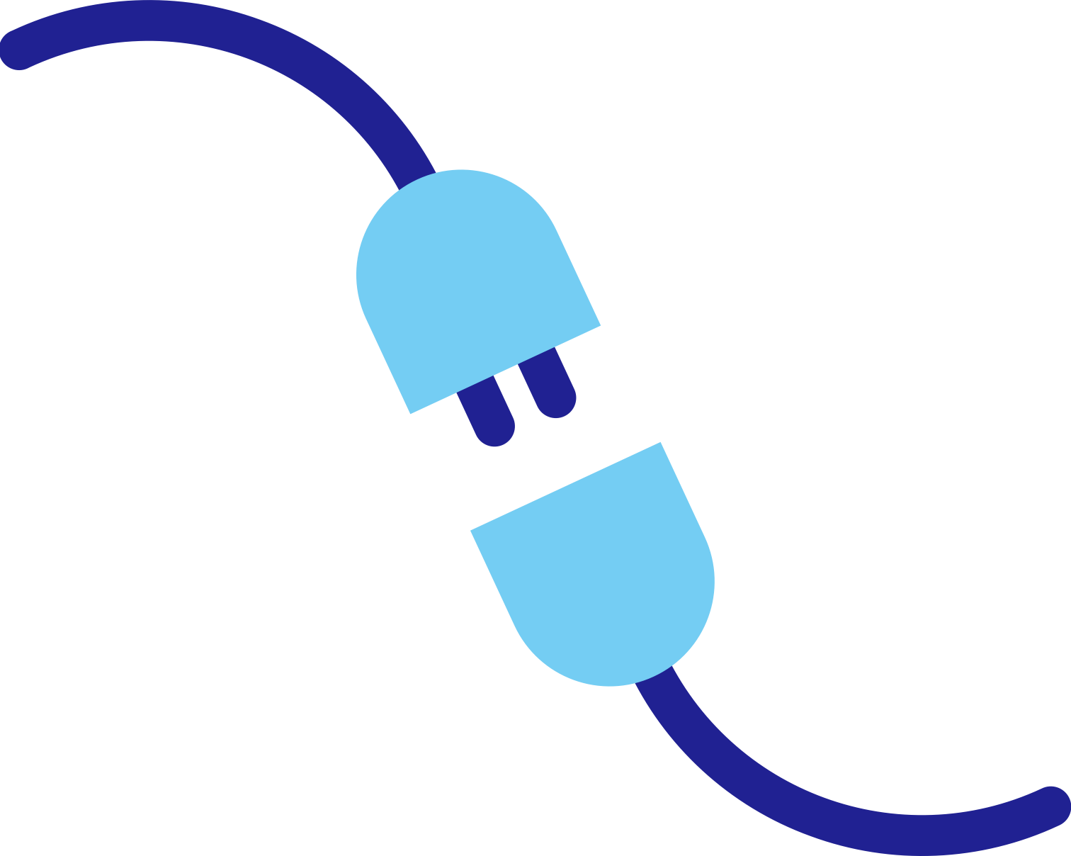
Inbound component resiliency policies
1
Resiliency polices for `retries`, `timeouts and `circuit breakers` can be applied to inbound component calls. For example, pub/sub subscriptions and input bindings
Service A
Inbound
Cron Input Binding

Slide 26
DEMO
Lap around Dapr

Slide 27
Future Roadmap
Best on Cloud
LTS and stable cloud components, managed Dapr in App Service, Functions, Logic apps and more
Next-gen QoS & Resiliency
Dapr for microservices, built-in flow control strategy, circuit breaker with downgrade rules, and more
Dapr Workflow
built with DTFx + Actors, comes with Dapr enabled integrations (100+ cross multiple clouds and still expanding)
Dapr in Functions
out-of-box solution for developers to build event-driven serverless app with Dapr + KEDA enabled ACA/AKS/…
.NET + Dapr
easy, natural, programmable cloud-native capabilities for .Net developers, via Dapr
Pluggable Components
bring your own component to Dapr in any language, any arch

Slide 28
Appendix

Slide 35

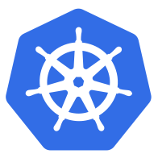



Azure Container Apps
Public preview
Serverless containers for microservices
Build modern apps on open source
Focus on apps, not infrastructure
Seamlessly port to Kubernetes
Kubernetes
KEDA
DAPR
Envoy
Builds on Kubernetes, providing a fully managed and optimized environment
Notes:
We’re constantly seeing customers citing Kubernetes complexity as a blocker from adopting containers and microservices application patterns.
At Microsoft Ignite, we announced the public preview of Azure Container Apps.
Azure Container Apps is built on a foundation of powerful open-source technology to deliver the same microservices benefits as Kubernetes as a fully managed and serverless app hosting option. Behind the scenes, every container app runs on Azure Kubernetes Service, with Kubernetes Event Driven Autoscaling (KEDA), Distributed Application Runtime (Dapr), and Envoy deeply integrated in the hosting service. However, developers and operators are not exposed to this underlying Kubernetes infrastructure. The open-source centric approach enables a path for teams to build microservices without having to overcome the concept and operational overhead of working with Kubernetes directly and enables continued app portability by leveraging open standards and APIs

Slide 36
What can you build with Azure Container Apps?
Event-driven processing
Public API endpoints
Background processing
Microservices
MICROSERVICE A
MICROSERVICE B
HTTP TRAFFIC
MICROSERVICE C
80%
20%
REVISION 1
REVISION 2
Deploy and manage a microservices architecture with the option to integrate with DAPR.
E.g. queue reader application that processes messages as they arrive in a queue.
HTTP requests are split between two versions of the container app where the first revision gets 80% of the traffic, while a new revision receives the remaining 20%.
E.g. continuously-running background process that transforms data in a database.
AUTO-SCALE CRITERIA
AUTO-SCALE CRITERIA
AUTO-SCALE CRITERIA
AUTO-SCALE CRITERIA
Individual microservices can
scale independently using any KEDA scale triggers
Scaling is determined by the number of messages in the queue
Scaling is determined by the number of concurrent HTTP requests
Scaling is determined by the level of CPU or memory load
Notes:
You may be wondering what sort of applications can you build with Azure Container Apps?
Here are some common ones including:
Deploying API endpoints
Hosting background processing applications
Handling event-driven processing
Running microservices
With each of those applications, you can dynamically scale based on:
HTTP traffic
Event-driven processing
CPU or memory load
Any KEDA-supported scaler

Slide 37
Environments
Environment (virtual network boundary)
Container app 1
Revision 1
Revision 2
Pod
Pod
Environments define an isolation and observability boundary around a collection of container apps deployed in the same virtual network
Container(s)
Container(s)
Container app 2
Revision 1
Revision 2
Pod
Pod
Container(s)
Container(s)
Notes:
Individual container apps are deployed to a single Container Apps environment, which acts as a secure boundary around groups of container apps. Container Apps in the same environment are deployed in the same virtual network and write logs to the same Log Analytics workspace.
Reasons to deploy container apps to the same environment include situations when you need to:
Manage related services
Deploy different applications to the same virtual network
Have applications communicate with each other using Dapr
Have applications to share the same Dapr configuration
Have applications share the same log analytics workspace
Reasons to deploy container apps to different environments include situations when you want to ensure:
Two applications never share the same compute resources
Two applications can't communicate with each other via Dapr

Slide 38
Containers
Environment (virtual network boundary)
Container app 1
Revision 1
Revision 2
Pod
Pod
Pod
Pod
Containers in Azure Container Apps can use any and development stack of your choice
Container(s)
Container(s)
Container(s)
Container(s)
Container app 2
Revision 1
Revision 2
Pod
Pod
Container(s)
Container(s)
Notes:
Azure Container Apps manages the details of Kubernetes and container orchestrations for you. Containers in Azure Container Apps can use any runtime, programming language, or development stack of your choice.
Azure Container Apps supports:
Any Linux-based container image
Containers from any public or private container registry
However, Azure Container Apps can't run privileged containers or processes that requires root access.
Additional features include:
There is no required base container image.
Changes to the template ARM configuration section triggers a new container app revision.
If a container crashes, it automatically restarts.
You can define multiple containers in a single container app. Groups of containers are known as pods. The containers in a pod share hard disk and network resources and experience the same application lifecycle.
Reasons to run containers together in a pod include:
Use a container as a sidecar to your primary app.
Use of a shared disk space and virtual network.
Share scale rules among containers.
Group together multiple containers that need to always run together.
Enable direct communication among containers on the same host.

Slide 39
Revisions
Environment (virtual network boundary)
Container app 1
Revision 1
Revision 2
Pod
Pod
Pod
Pod
Revisions are immutable version snapshots of a container app
Container(s)
Container(s)
Container(s)
Container(s)
Container app 2
Revision 1
Revision 2
Pod
Pod
Container(s)
Container(s)
Notes:
A revision is an immutable snapshot of a container app.
The first revision is automatically created when you deploy your container app.
New revisions are automatically created when a container app's template configuration changes.
While revisions are immutable, they're affected by changes to global configuration values, which apply to all revisions.
Revisions are most useful when you enable ingress to make your container app accessible via HTTP. Revisions are often used when you want to direct traffic from one snapshot of your container app to the next. Typical traffic direction strategies include A/B testing and BlueGreen deployment.

Slide 40
Ingress
Environment (virtual network boundary)
Container app 1
Revision 1
Revision 2
Pod
Pod
Pod
Pod
Internal or external visibility with TLS termination and support for HTTP/1.1 and HTTP/2
Container(s)
Container(s)
Container(s)
Container(s)
80%
20%
Ingress
Notes:
Azure Container Apps allows you to expose your container app to the public web by enabling ingress. When you enable ingress, you do not need to create an Azure Load Balancer, public IP address, or any other Azure resources to enable incoming HTTPS requests.
With ingress enabled, your container app features the following characteristics:
Supports TLS termination
Supports HTTP/1.1 and HTTP/2
Endpoints always use TLS 1.2, terminated at the ingress point
Endpoints always expose ports 80 (for HTTP) and 443 (for HTTPS).
By default, HTTP requests to port 80 are automatically redirected to HTTPS on 443.
Your ingress IP and fully qualified domain name can either be visible externally to the internet, or internally within a VNET. With ingress enabled, your application is assigned a fully qualified domain name (FQDN).
Your Container Apps environment has a single public IP address for applications with external ingress visibility, and a single internal IP address for applications with internal ingress visibility. Therefore, all applications within a Container Apps environment with external ingress visibility share a single public IP address. Similarly, all applications within a Container Apps environment with internal ingress visibility share a single internal IP address. HTTP traffic is routed to individual applications based on the FQDN in the host header.

Slide 41




Environment (virtual network boundary)
Container app 1
GitHub Actions integration
Revision 1
Revision 2
Pod
Pod
Pod
Pod
Publish revisions as commits are pushed to your GitHub repository by triggering a GitHub Action to build a new container image
Container(s)
Container(s)
Container(s)
Container(s)
Build container using GitHub Action
Azure Container Registry
GitHub repository
Code check-in
Notes:
Use GitHub Actions to publish revisions to your container app. As commits are pushed to your GitHub repository, a GitHub Action is triggered which updates the container image in the container registry. Once the container is updated in the registry, Azure Container Apps creates a new revision based on the updated container image.
The github-action add command creates a GitHub Actions integration with your container app. You can also configure continuous deployment through the Azure Portal.

Slide 42
Secrets management
"template": {
"containers": [
{
"image": "myregistry/myQueueApp:v1",
"name": "myQueueApp",
"env": [
{
"name": "QueueName",
"value": "myqueue"
},
{
"name": "ConnectionString",
"secretref": "queue-connection-string"
}
]
}
],
}
Securely store sensitive configuration elements that are then available to containers through environment variables, scale rules, and Dapr
Notes:
Azure Container Apps allows your application to securely store sensitive configuration values. Once defined at the application level, secured values are available to containers, inside scale rules, and via Dapr.
Secrets are scoped to an application, outside of any specific revision of an application.
Adding, removing, or changing secrets does not generate new revisions.
Each application revision can reference one or more secrets.
Multiple revisions can reference the same secret(s).
When a secret is updated or deleted, you can respond to changes in one of two ways:
Deploy a new revision.
Restart an existing revision.

Slide 43

Logging
Environment
Container app 1
Revision 1
Revision 2
Pod
Pod
Containers write logs to standard output or standard error streams surfaced via Log Analytics
Container(s)
Container(s)
stderr/stdout
stderr/stdout
Log Analytics
Notes:
Azure Container Apps gathers a broad set of data about your container app and stores it using Log Analytics. You can then use the Azure CLI or the Azure Portal to run queries against your Log Analytics workspace and visualize the results.

Slide 44
Scaling and using the Kubernetes Event Driven Autoscaling (KEDA)

Slide 45





Application autoscaling made simple Open-source, extensible, and vendor agnostic
Metrics Adapter | Controller | Scaler
Intelligently scale your event-driven applications
Out-of-the-box scalers for various vendors, databases, messaging systems, telemetry systems, CI/CD, and more
Event-driven
Built-in scalers
Kubernetes-based Event Driven Autoscaler
Support for triggers across variety of cloud providers & products
Bring rich scaling to every workload
Vendor-agnostic
Rich capabilities
Drive the scaling of any container based on a growing list of 35+ event sources, known as: scalers
keda.sh

Slide 46
Scaling
KEDA
HTTP
Event-driven
CPU
Memory
{
"name": "http-rule",
"http": {
"metadata": {
"concurrentRequests": 50
}
}
}
artemis-queue, kafka, aws-cloudwatch, aws-kinesis-stream, aws-sqs-queue, azure-blob, azure-eventhub, azure-servicebus, azure-queue, cron, external, gcp-pubsub, huawei-cloudeye, ibmmq, influxdb, mongodb, mssql, mysql, postgresql, rabbitmq, redis, redis-streams, selenium-grid, solace-event-queue, ..
{
"name": "cpu-rule",
"custom": {
"type": "cpu",
"metadata": {
"type": "Utilization",
"value": "50"
}
}
}
{
"name": "mem-rule",
"custom": {
"type": "memory",
"metadata": {
"type": "AverageValue",
"value": "512"
}
}
}
Support for scale to zero and specifying minimum/maximum replicas
Support for specifying minimum/maximum replicas
Notes:
When it comes to scaling, you have a number of choices here, some of which support scaling to zero.
Both HTTP scaling and Event-driven scaling support scaling to zero when there are no requests, or when there are no events to process.
HTTP scaling
With an HTTP scaling rule, you have control over the threshold that determines when to scale out. You define the maximum number of concurrent requests. Once the number of requests exceeds this value, then more replicas are added, up to the maxReplicas amount.
Event-driven scaling
Container Apps can scale based of a wide variety of event types. Any event supported by KEDA, is supported in Container Apps. Examples include: …
CPU scaling
CPU scaling allows your app to scale in or out depending on how much the CPU is being used utilizing the KEDA CPU scale trigger.
Memory scaling
Memory scaling allows your app to scale in or out depending on how much memory is being used utilizing the KEDA Memory scaler
You also have a choice to set a minimum number of instances that will always be up and running. Those will then be charged at a reduced “Idle” rate as long as those applications are not processing requests.

Slide 48
Demo

Slide 49

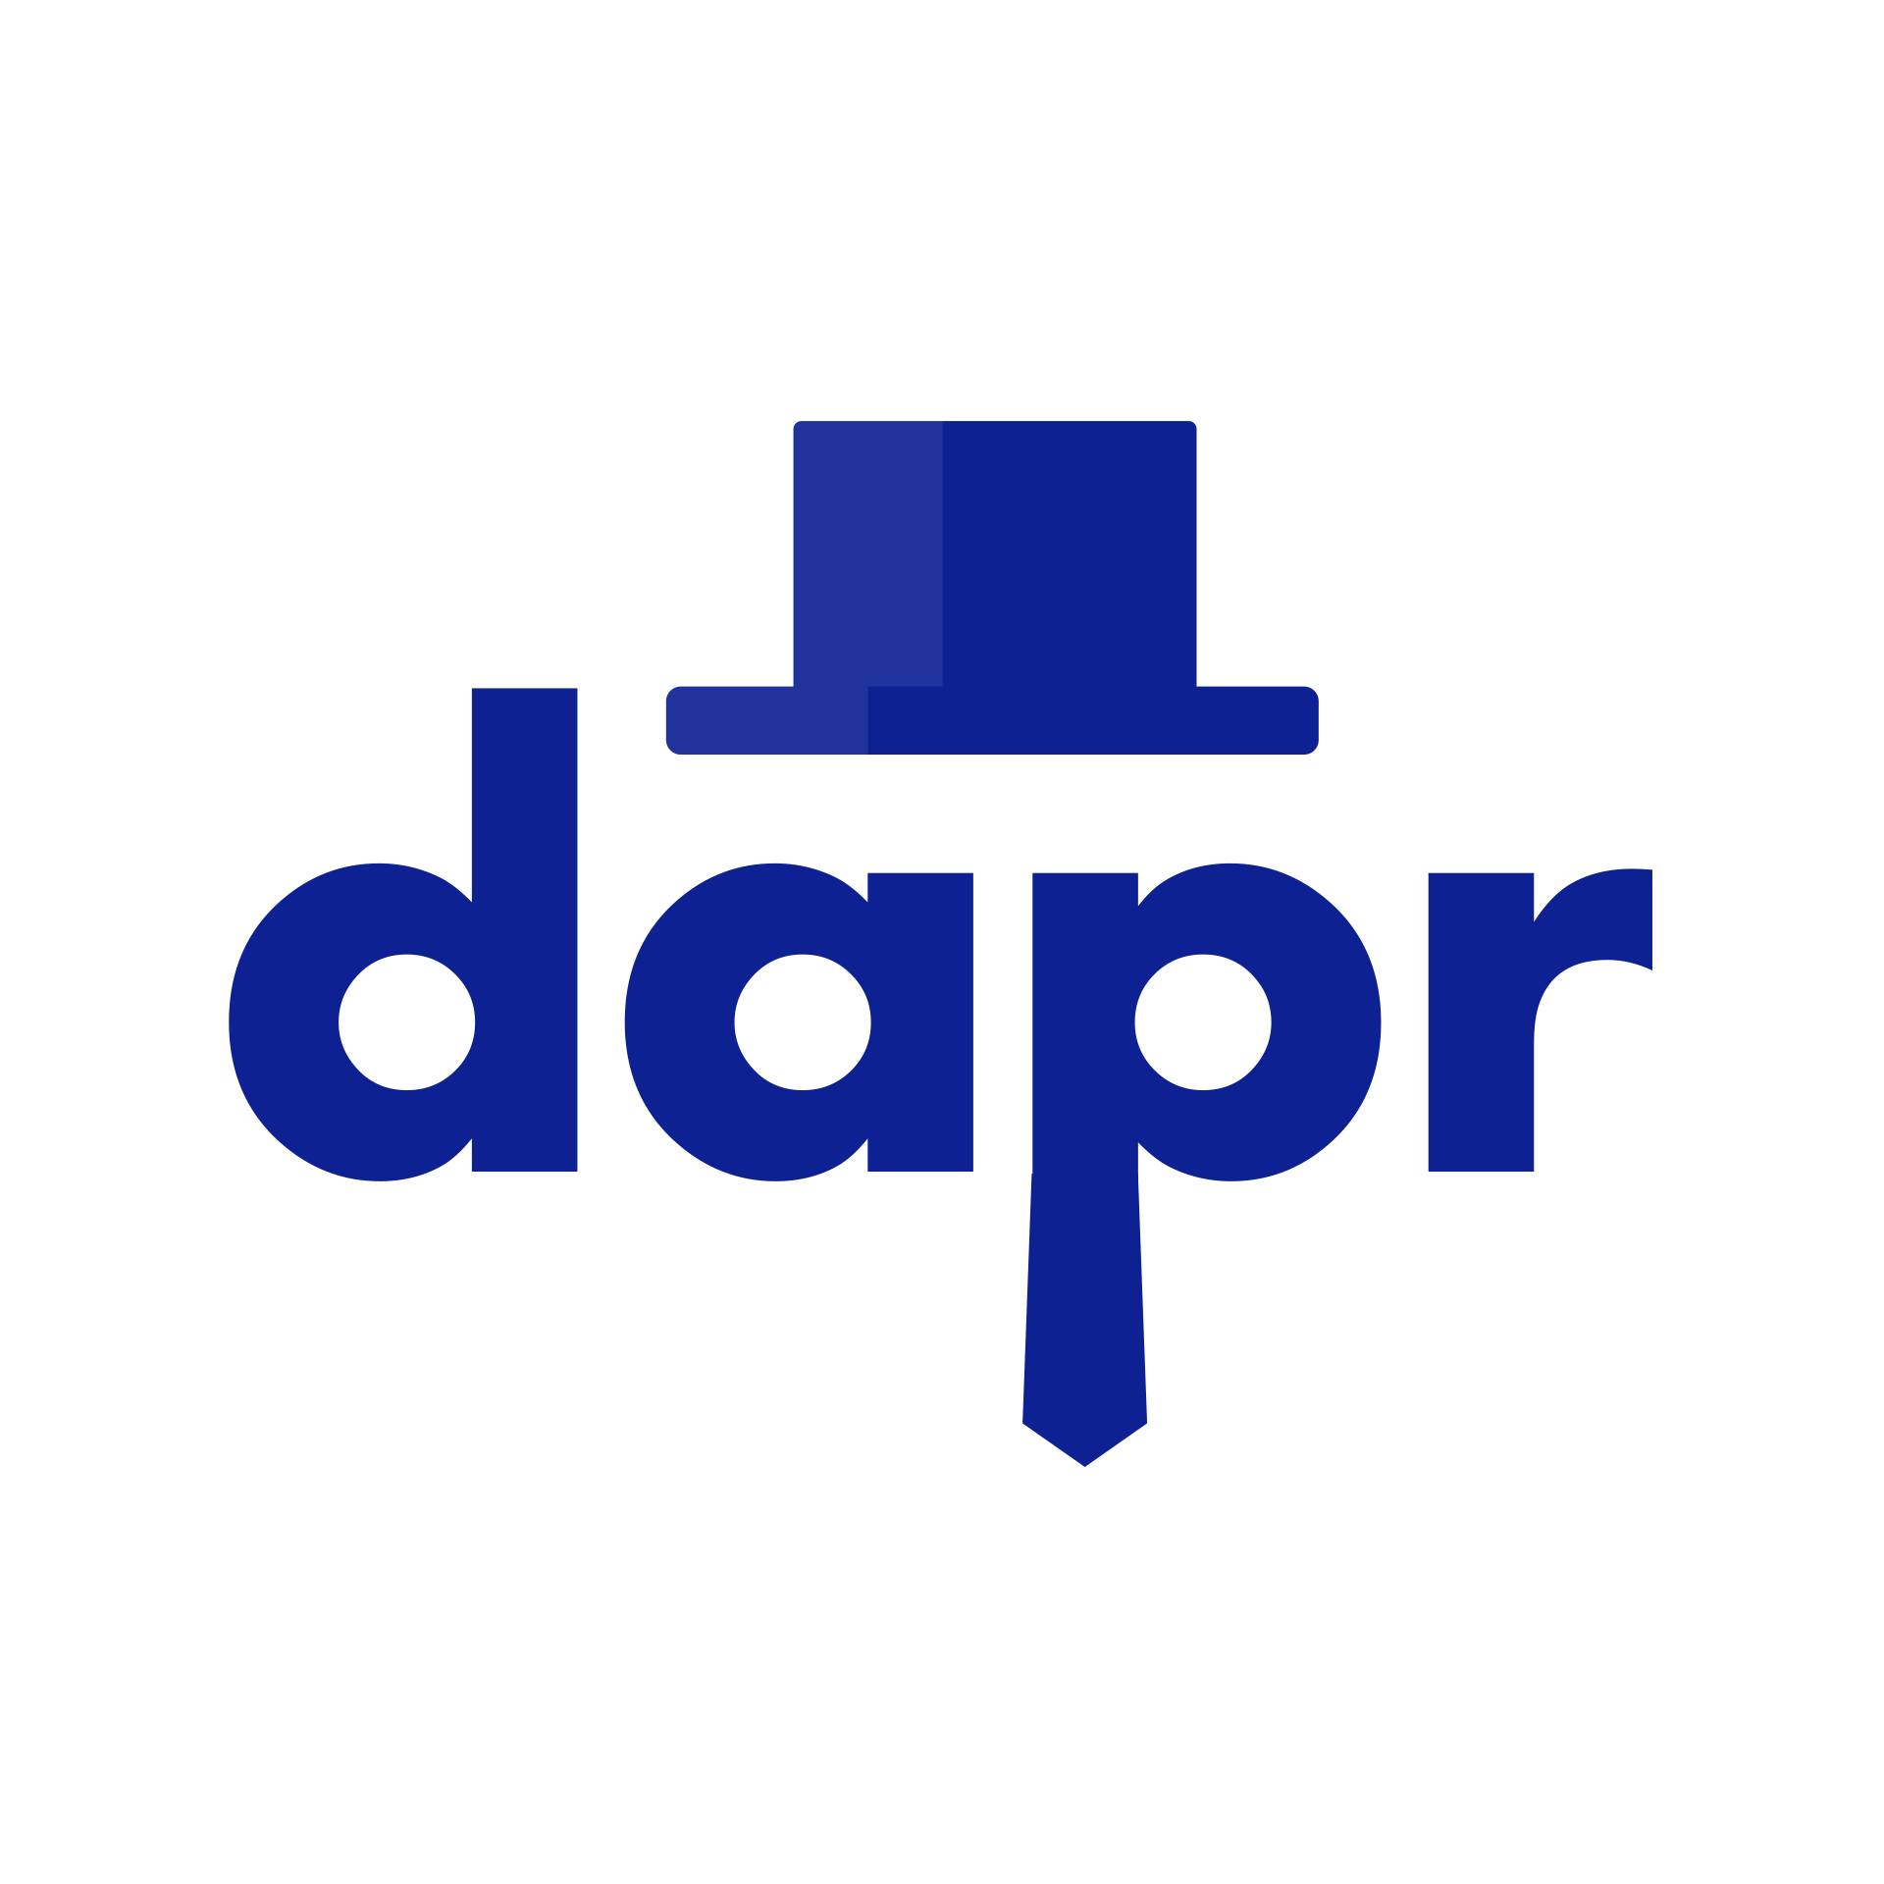
Twitter Binding Component
You
Service Invocation
Twitter Provider
Sentiment Processor
Tweet Viewer
State Component
PubSub Component

Slide 50
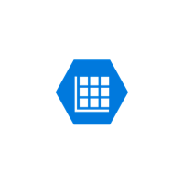
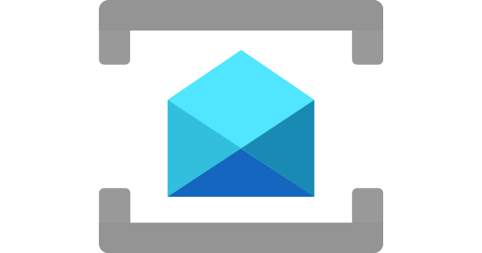
Twitter Binding Component
You
Service Invocation
Twitter Provider
Sentiment Processor
Tweet Viewer
Azure Table Storage
Azure Service Bus Component

